Slide 1
TLRISC-V Design Spec
Created by TuanLa
Designing RISC-V RV32I

Slide 2
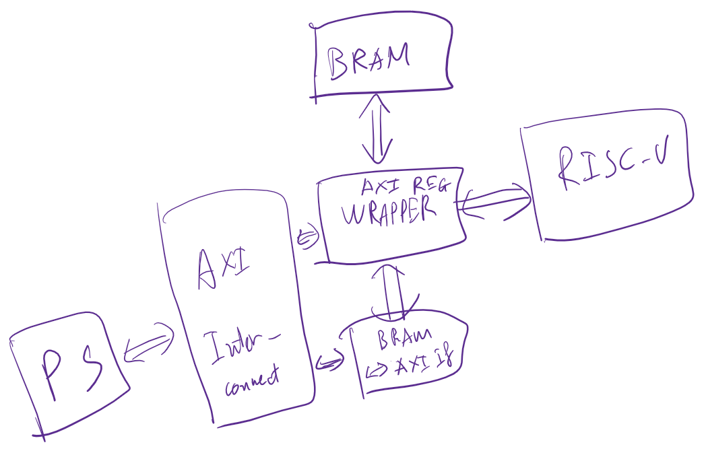
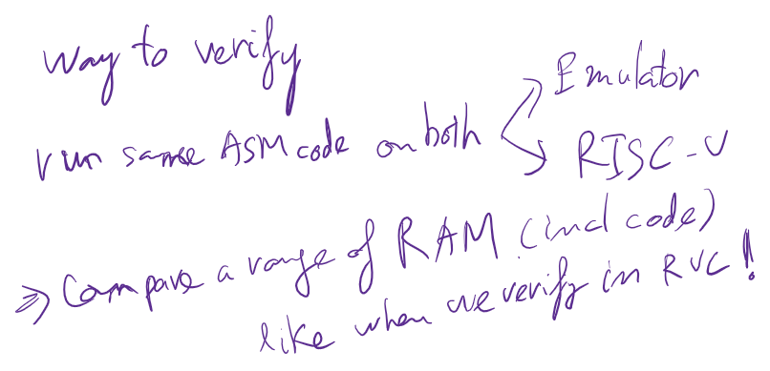




Overall

Slide 3
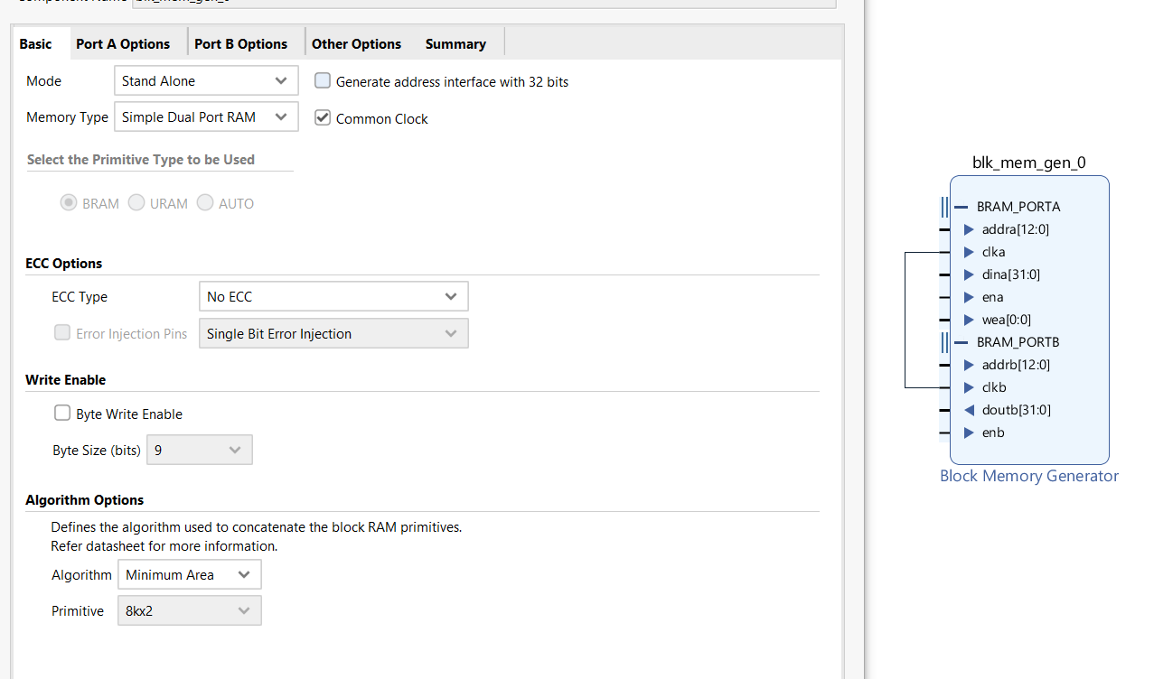












Overall

Slide 4
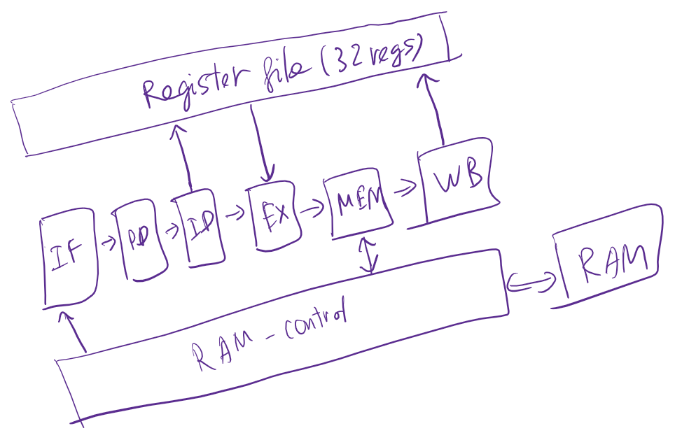

Overall

Slide 5
Conventions
Naming: <master>_<slave>_<signal>
Naming: <stage>_<signal>
Enable of Pipeline FFs (except vld FFs): CEN = (!stall & vld); // vld here is for power saving
Valid FFs: CEN = !stall; // When vld = 1’b0 (flusing), the pipeline still runs.

Slide 6































Slide 7












IF

Slide 8

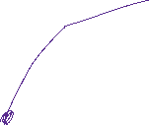













Slide 9















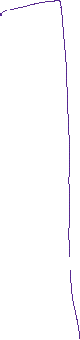

























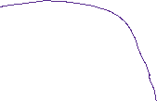












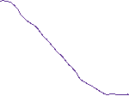


Slide 10
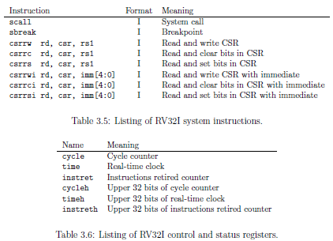
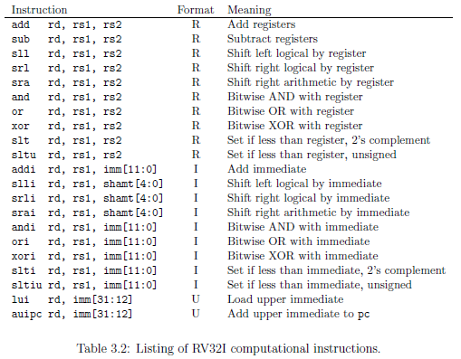
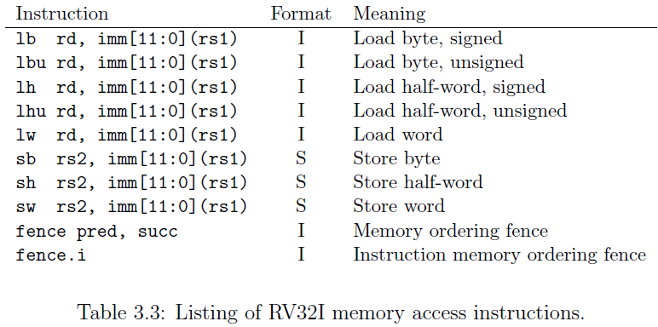
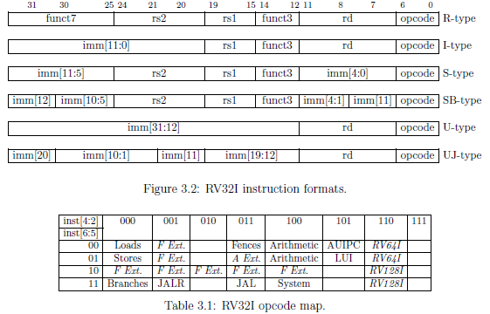
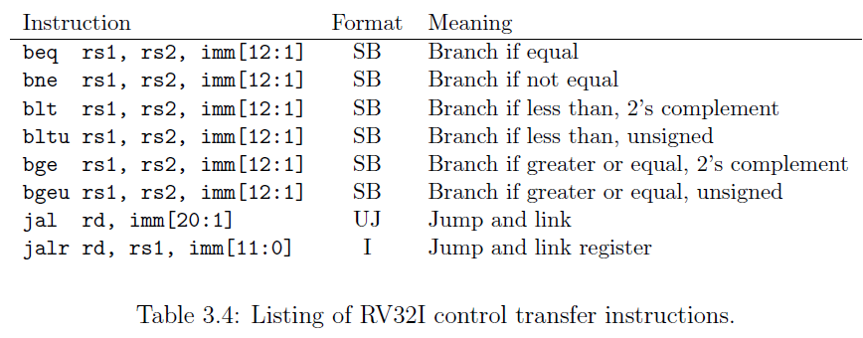
Instructions

Slide 11














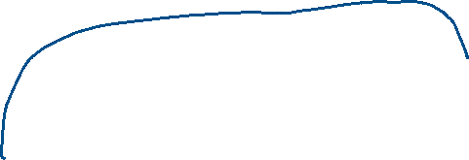
















Overview Design

Slide 12
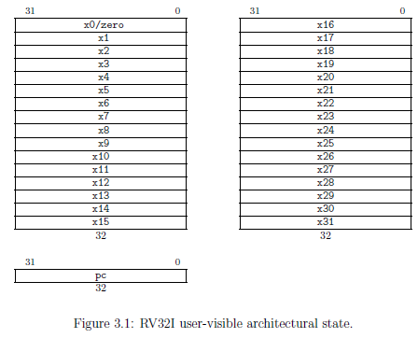









REGFILE: Registers File
31x32-bit reg (r1-r31) + r0 (always = 0) + 1 PC

Slide 13
















RAM Controller
Write to RAM: wadd, wdata[31:0], wenb
Read from RAM: radd, rdata[31:0]
Write: always write from MEM.
Read: either from MEM or IF. First come first serve!
Busy signals to MEM and IF.

Slide 14


RAM Controller
MEM read has higher priority than IF read. (downstream needs to be released)
Request then get data after 1 clock cycle.
MEM write will always be processed.

Slide 15













IF: Instruction Fetch
IF always requests each cycle so no need for REQ signal!
Only busy signal from RAM is required!
For Fetching Instruction from RAM:
In: RAM_IF_rdata, RAM_IF_busy
OUT: IF_RAM_radd
It DOESN’T have branch delay slots!
PC is intercepted when: branch or jump.
For other blocks:
In: EX_IF_pcupdate, EX_IF_pcnew
Out: IF_pc, IF_inst, IF_vld
For flushing:
In: EX_flush
Common signals: clk, rst

Slide 16




ID: Instruction Decode
Only decode when receiving valid signal from IF.
Opc = inst[6:0]
Rd= inst[11:7]
Imm[0] = (i-type) ? Inst[20] : Inst[7] // s-type
Imm[4:1] = (s-type || sb-type) ? inst [11:8] : inst [24:21] // i-type or uj-type
Imm[10:5] = inst[30:25] // i-type or s-type or sb-type or uj-type
Imm[11] = (i-type || s-type) ? Inst[31] : (sb-type) ? Inst[7] : inst[20] // uj-type
Imm[12] = (sb-type) ? Inst[31] : inst[12] // u-type or uj-type
Imm[19:13] = inst[19:13] // u-type or uj-type
Imm[20] = (u-type) ? Inst[20] : inst[31] // uj-type
Imm[31:21] = inst[31:21] // u-type
Rs1 = inst[19:15]
Rs2 = inst[24:20]
Funct3 = inst [14:12]
Funct7 = inst [31:25]
Inst[1:0] is set to 2’b11 as in base ISAs
Remain space is for extension

Slide 17
EX: Execute
Computation:
Add/Subtract by Registers/Immediate
Logical/arithmetic left/right shift by Registers/Immediate
Bitwise AND/OR/XOR by Registers/Immediate
Comparison by Registers/Immediate
Load/Add PC
Branch - Jump:
Branch if equal/not equal/less-great signed/less-great unsigned
Jump and link
Mem access:
Load/Store
Fences?

Slide 18







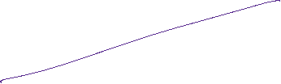























EX: Execute – Branch Taken + Flush
Output: EX_IF_pcupdate, EX_IF_pcnew
Input: EX_pc, EX_opcode, EX_rs1_val, EX_rs2_val
Flush objective: clear previous pipeline reg
Flush behavior: keep in 1 cycle, after that release.
rd will be written when flushing.
Flush signal == PC_update signal

Slide 19
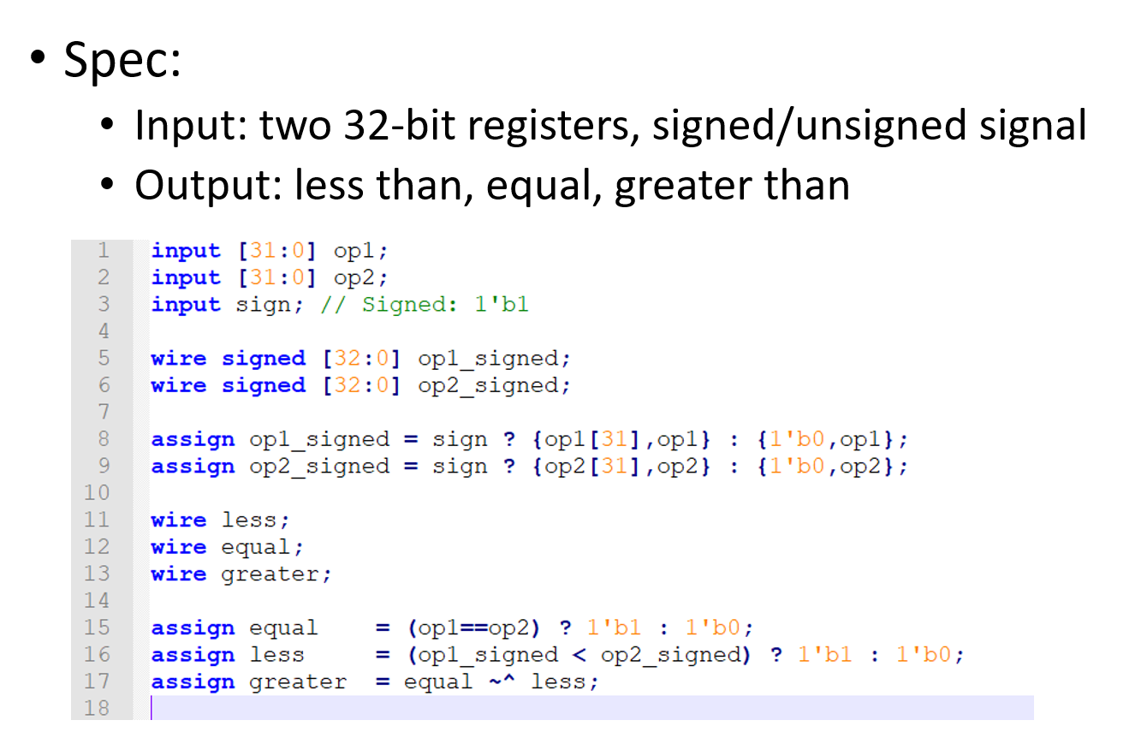


EX - Comparator
Spec:
Input: two 32-bit registers, signed/unsigned signal
Output: less than, equal, greater or equal than

Slide 20

































EX - Data Hazard Controller
This controls the reading of register file for 2 operands.
It prevents:
Operands are updated from previous adjacent instruction -> Solution: keep rd, no need to stall anything.
Operands are taken from MEM of the previous instruction -> Solution: add bubble, need to wait data from MEM.
Inputs: EX_rs1, EX_rs2, EX_rd, MEM_rd, MEM_rd_val, EX_opcode
Outputs: EX_rs1_val, EX_rs2_val, EX_busy

Slide 21
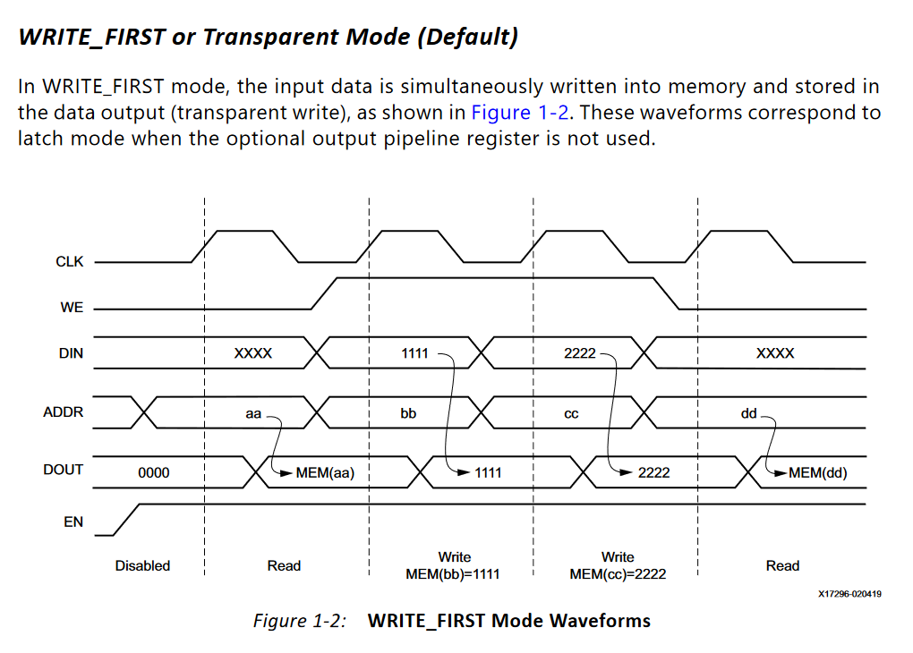





Slide 22



